Slide 1
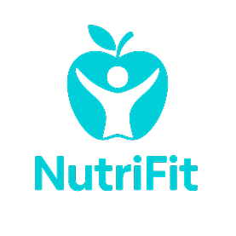
Track | Train | Transform
Group 11
Kishan Thakor (202201217)
Heman Chauhan (202201267)
Kishan Pansuriya (202201504)

Slide 2
Problem Statement
Modern lifestyle challenges make it difficult for individuals to maintain consistent workout routines, healthy eating habits, and access proper fitness guidance.
Traditional methods like manual tracking, generic fitness apps, and one-size-fits-all plans often lead to frustration, burnout, and loss of motivation.
Diverse fitness goals—such as weight loss, muscle gain, endurance improvement, or general wellness—require personalized and adaptive solutions, which most current options fail to provide.
There is a strong need for a comprehensive, easy-to-use, and engaging fitness solution that offers real-time feedback, personalized guidance, and sustainable support for long-term health and fitness.

Slide 3
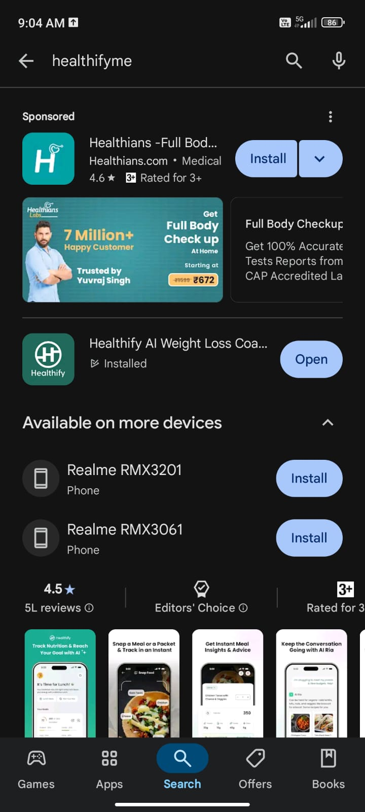
Competitive Analysis
Healthify
Strengths
Personalized Health Plans
AI Nutrition Assistant (Ria)
Personalized Health Plans
Weakness
No Community or Social Support
App Performance Issues
Limited Free Features

Slide 4
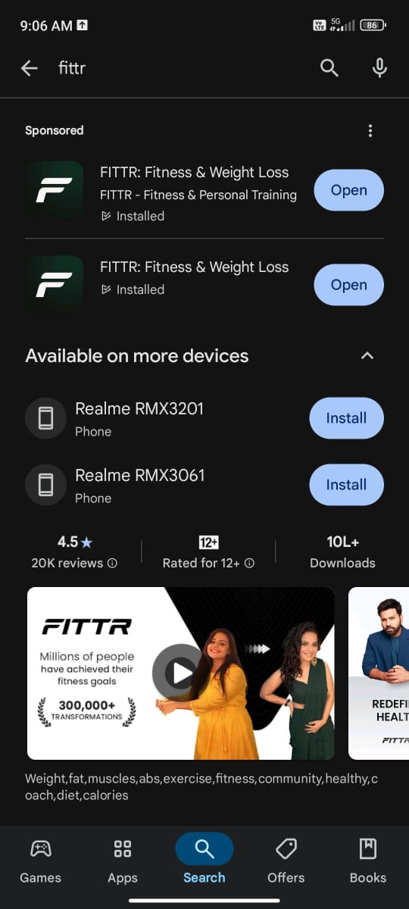
Competitive Analysis
FITTR
Strengths
Strong Focus on Fitness & Strength Training
Personalized Diet and Workout Plans
Free Resources
Weakness
Not Beginner-Friendly
Premium Plans Are Expensive
No AI Assistant
Limited Indian Food Database

Slide 5
User Survey
Which type of exercise do you prefer?
How much time do you spend exercising per week on average?
What challenges do you face in maintaining a consistent workout routine?
What is your primary goal with your diet?
What type of diet do you currently follow?
Do you track your calorie and nutrition intake?
What difficulties do you face in following a diet plan?
What is your biggest obstacle in tracking your health progress?
What support do you need to stick to your health goals?

Slide 6
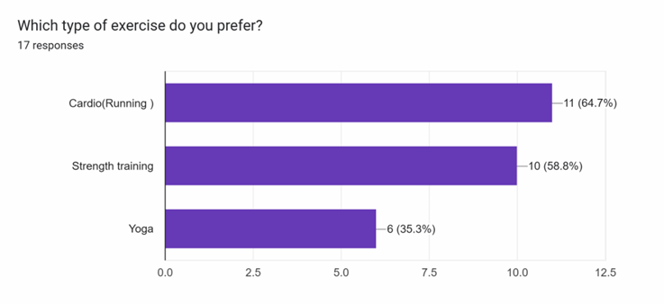
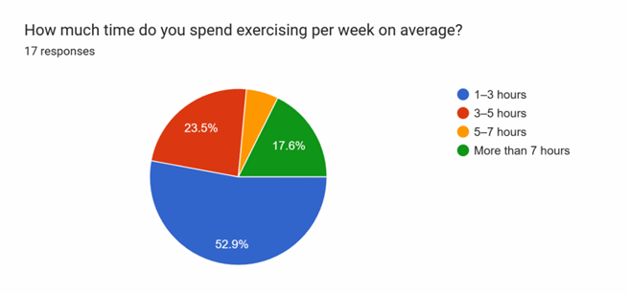
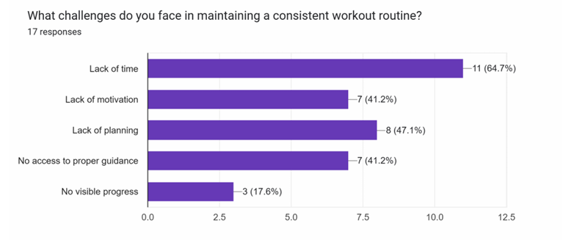
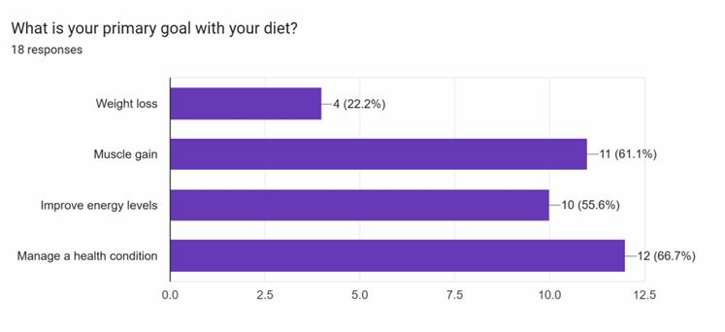
Survey Results
Most people prefer cardio and strength training, while fewer go for yoga.
They usually work out 1–3 hours a week, with time being the biggest barrier.
Health management, gaining muscle, and boosting energy are top diet goals.
Lack of motivation and planning also make it hard to stay consistent.

Slide 7
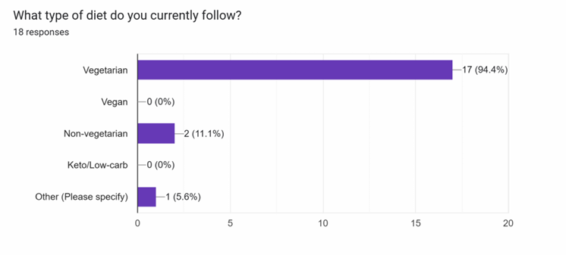
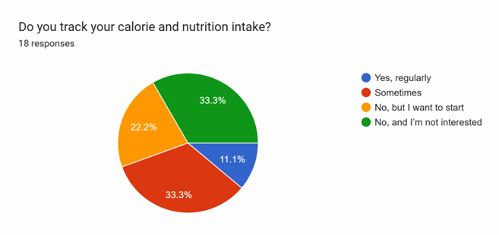
Survey Results
Most people follow a vegetarian diet, with very few choosing other types.
Calorie tracking is mixed—some do it regularly, while others don’t or aren’t interested.

Slide 8
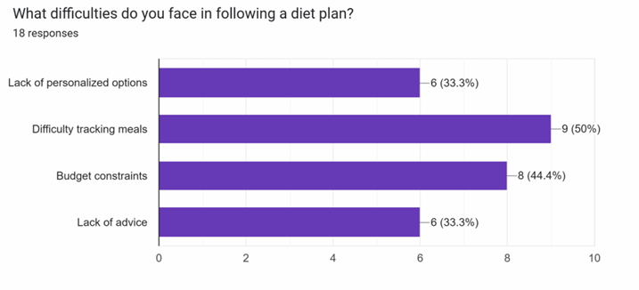
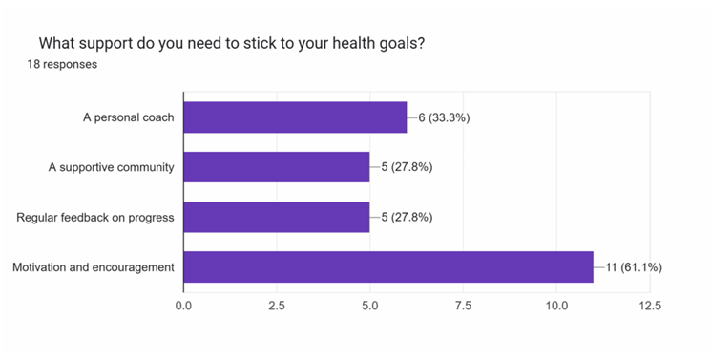
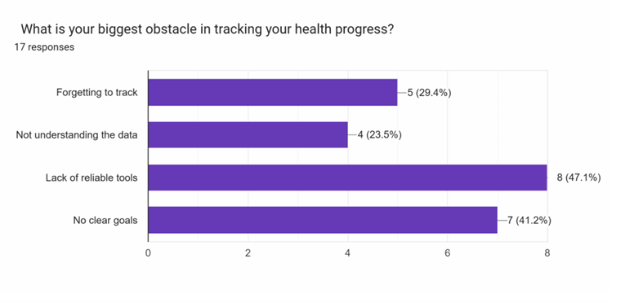
Survey Results
Many people struggle with tracking meals and sticking to a diet due to costs or lack of advice.
Motivation and encouragement are the top supports people need to reach their health goals.
Tracking progress is tough for some because of unclear goals or unreliable tools.
Forgetting to track and not understanding the data also get in the way

Slide 9

Design Overview
Living healthy is tough for everyone due to time, motivation, and consistency issues.
Many people still use old tools like journals or scattered apps, leading to confusion and burnout.
Most wellness platforms don’t fit everyone, missing out on different body types, fitness levels, and needs.
There’s a need for a simple, personalized, and inclusive solution that supports lasting health improvements for all.

Slide 10
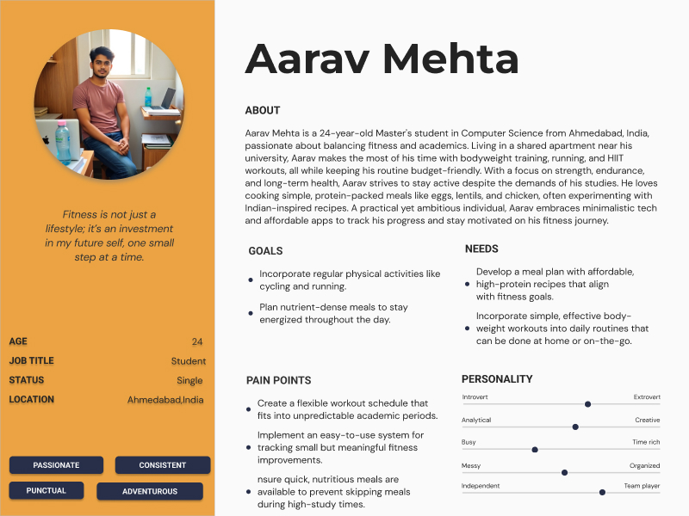
User Persona

Slide 11
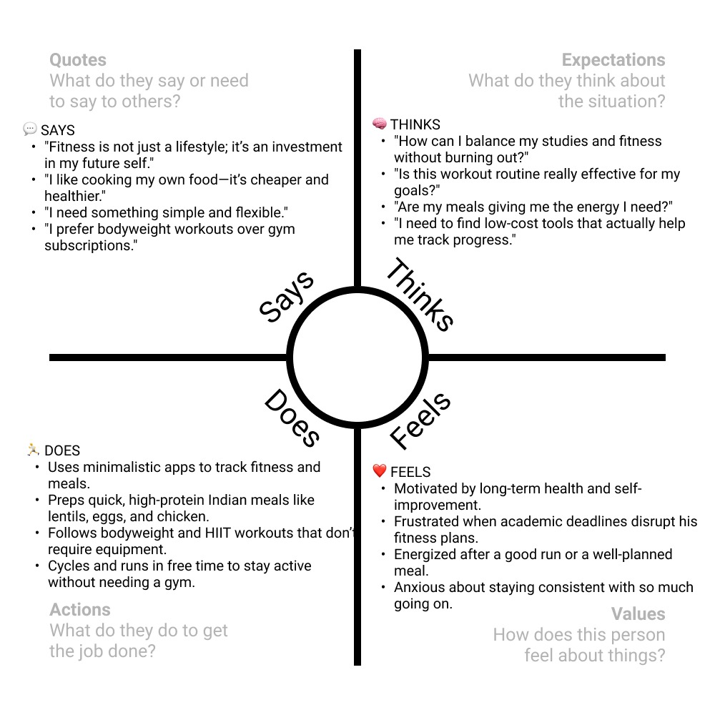
Empathy Mapping

Slide 12
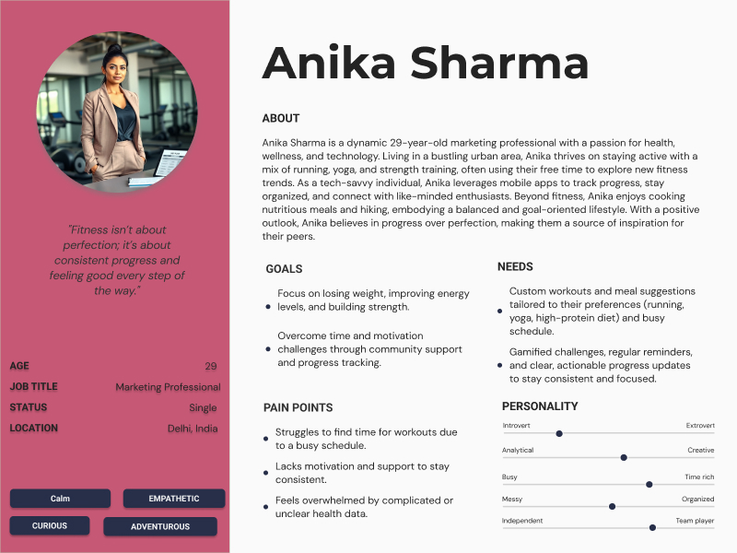
User Persona

Slide 13
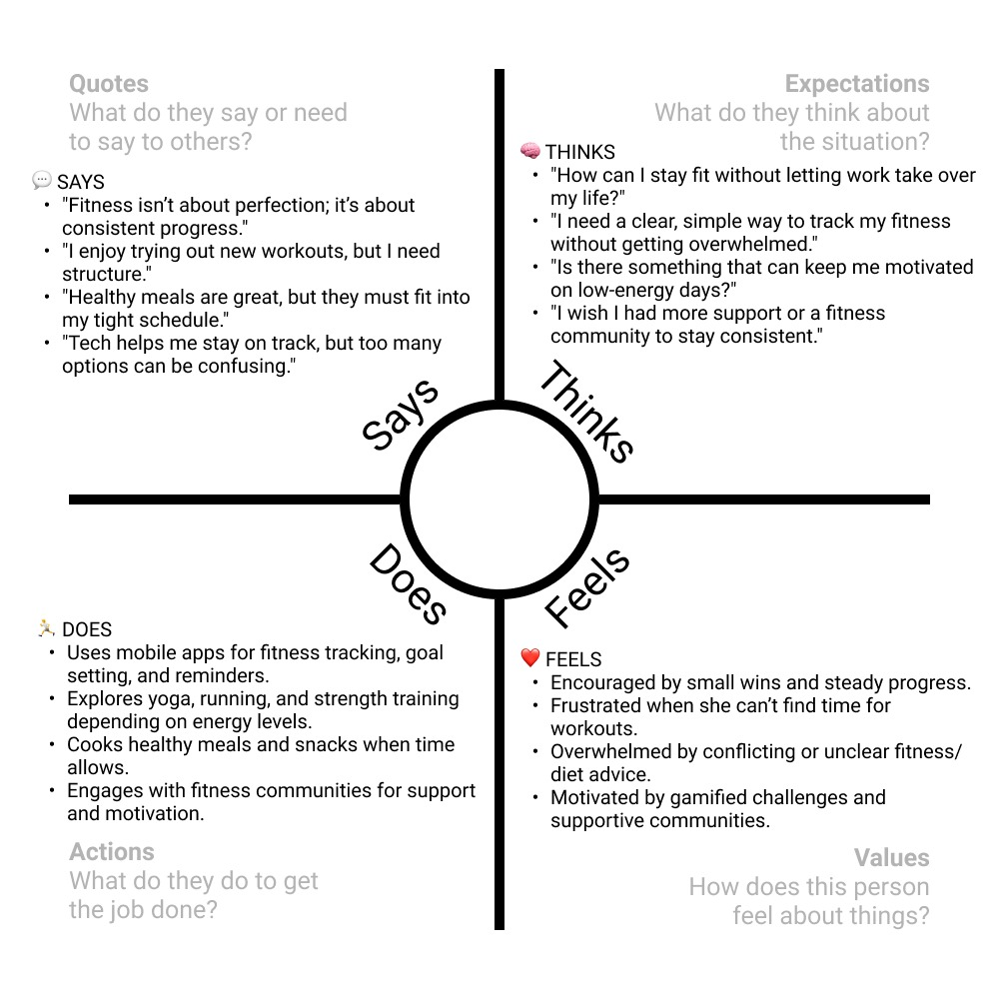
Empathy Mapping

Slide 14
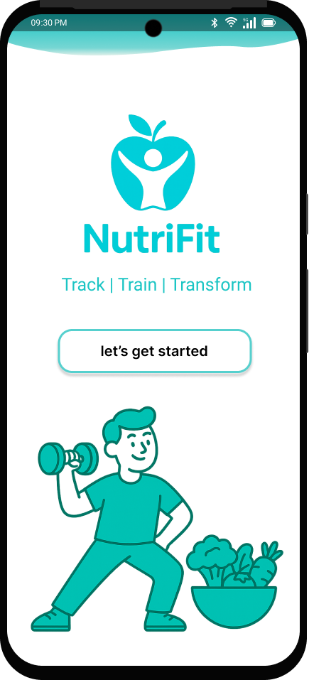
Nutrifit is a smart app that helps you stay on top of your health and fitness. It gives you personal nutrition tips, tracks your workouts, and shares useful health insights so you can build good habits that last.
Whether you want to lose weight, gain muscle, get stronger, or just live a healthier life, Nutrifit fits into your daily routine easily.
With the motto “Track. Train. Transform.”, Nutrifit is more than just an app—it’s your daily partner on the journey to better health and fitness.

Slide 15
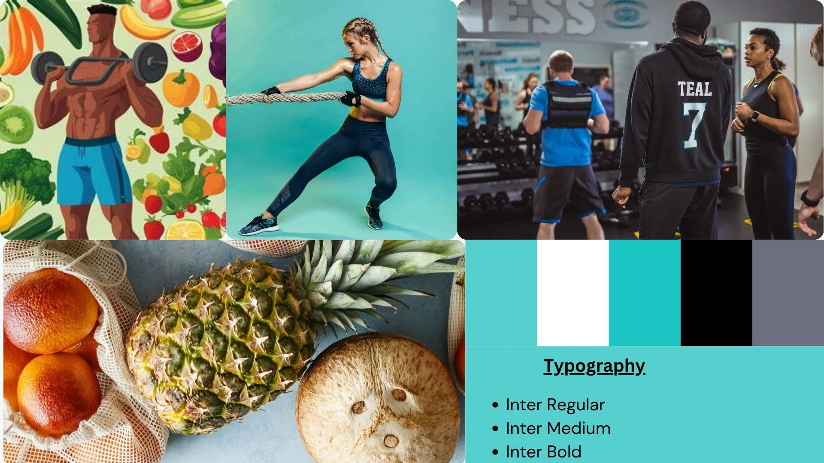
Mood Board

Slide 16
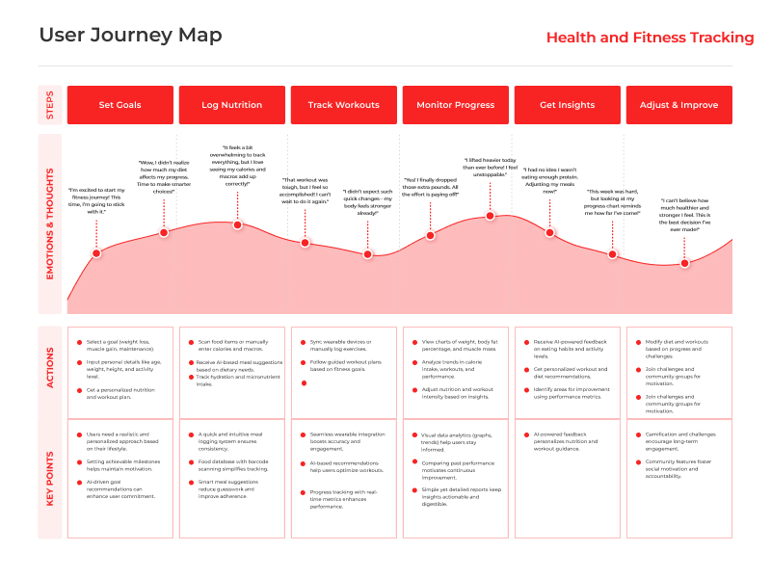

Slide 17
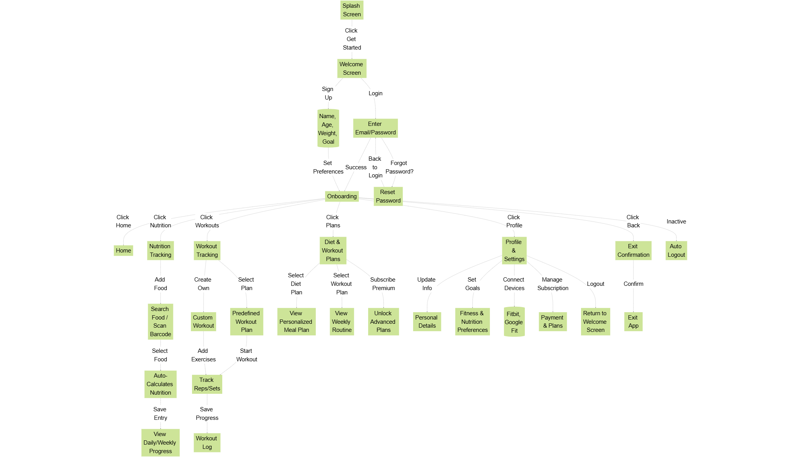
Information Architecture

Slide 18
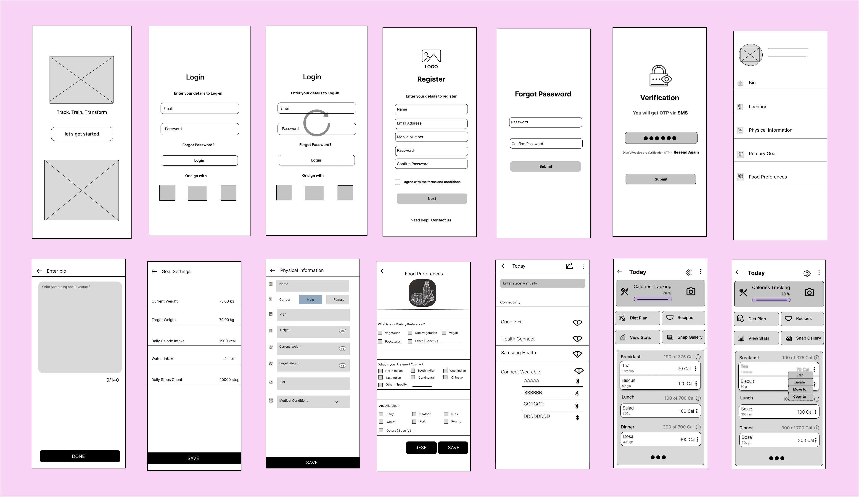
Low-Fidelity Wireframes

Slide 19
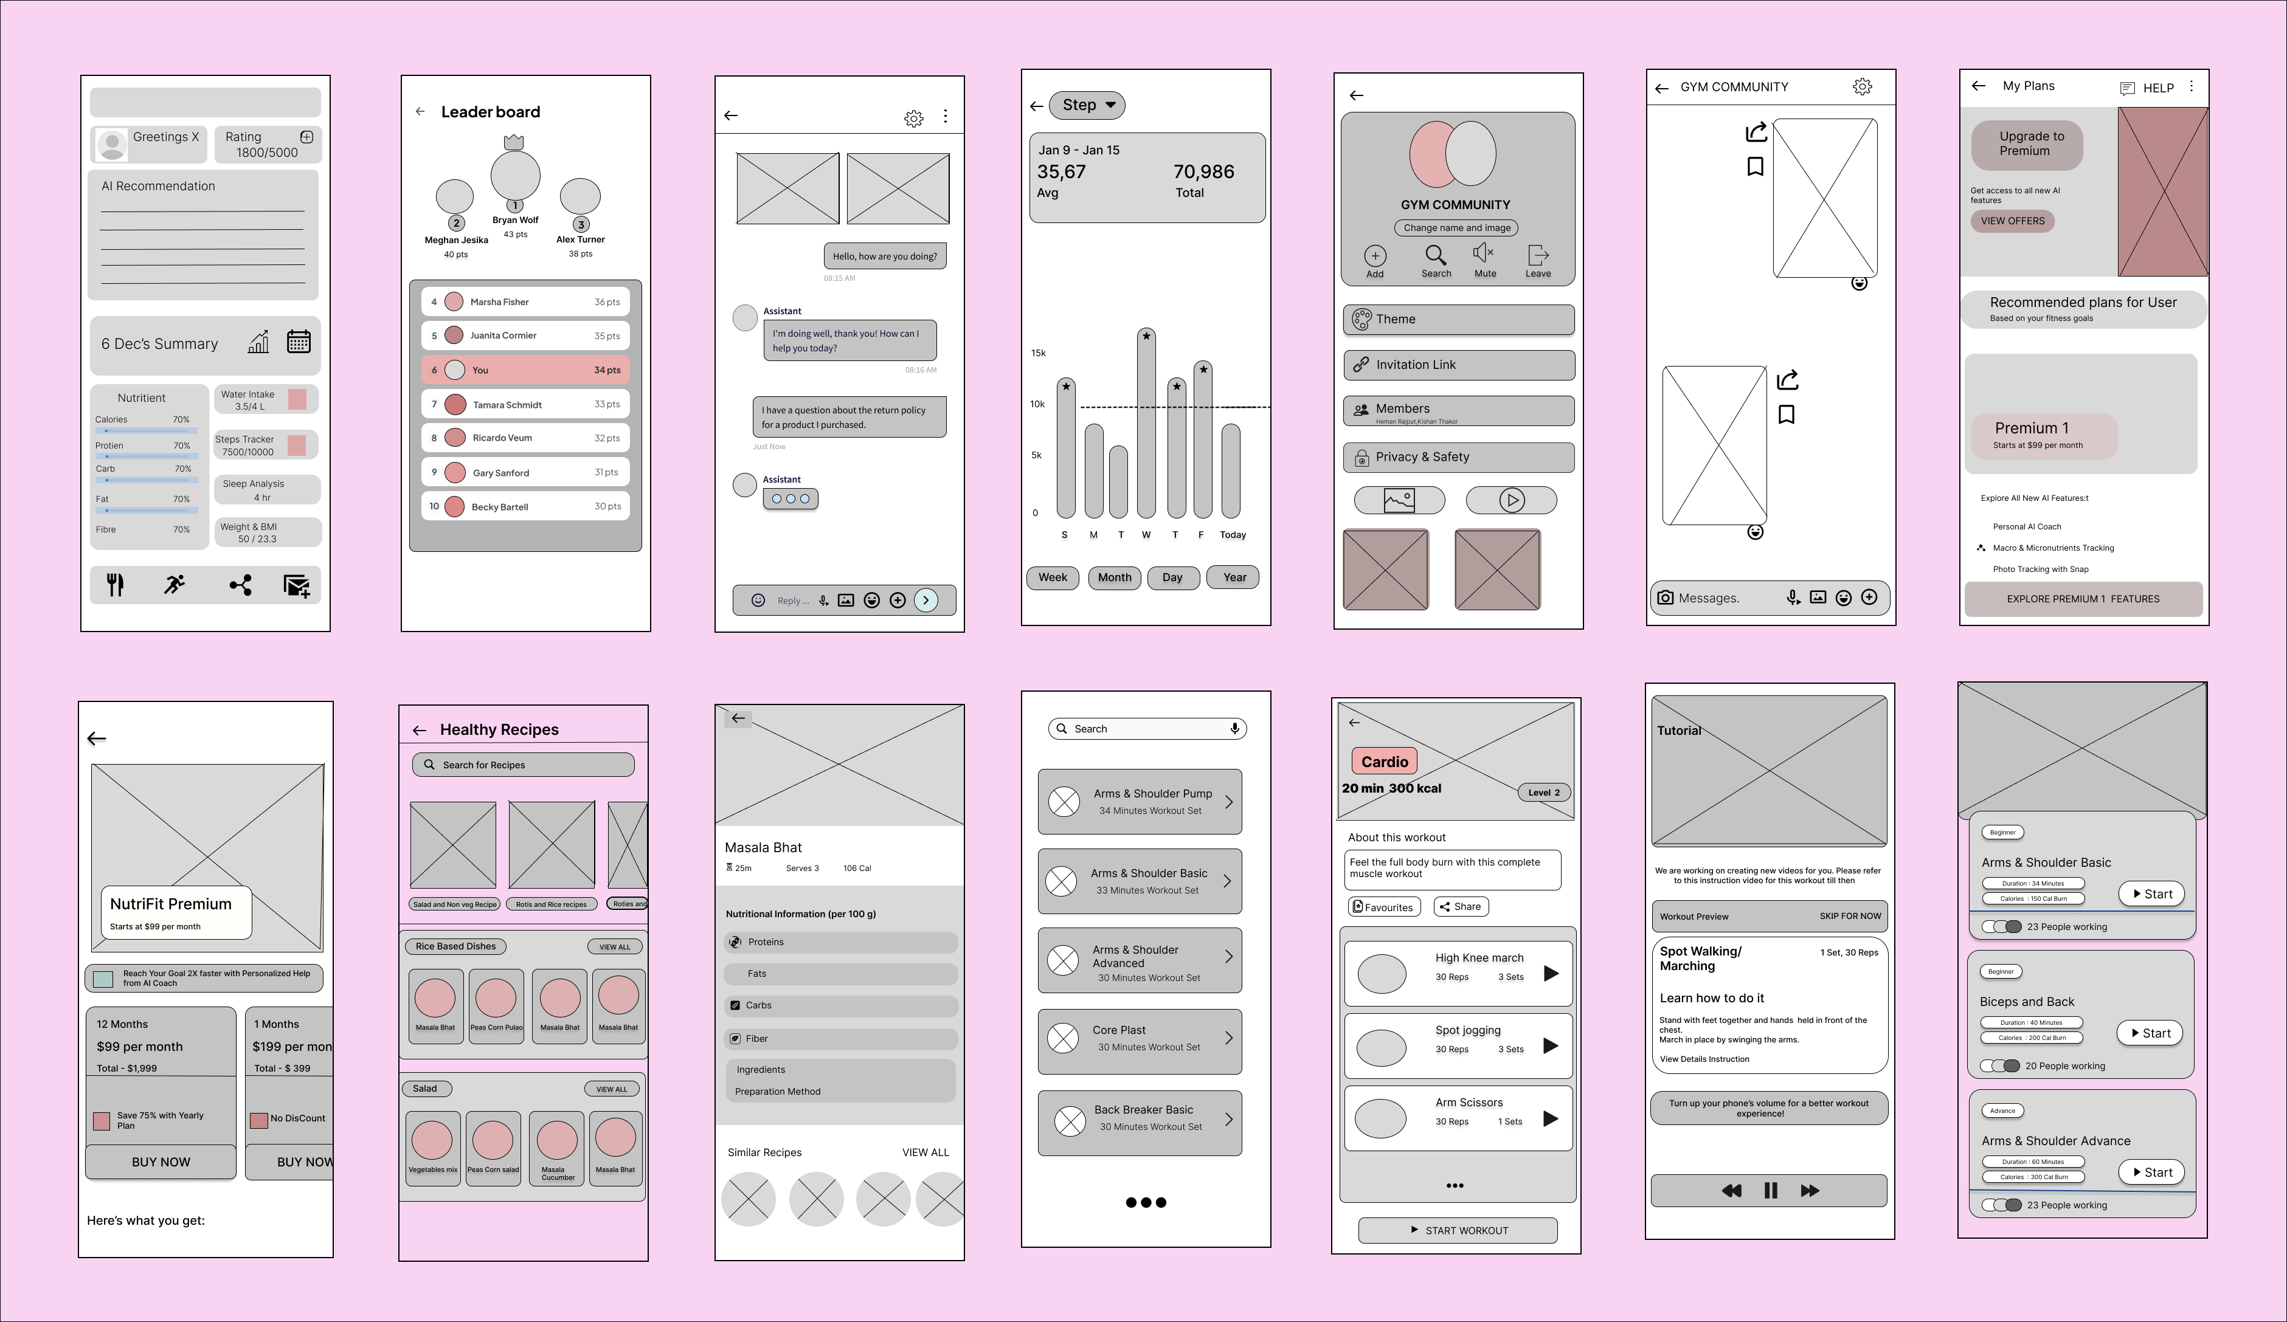

Slide 20
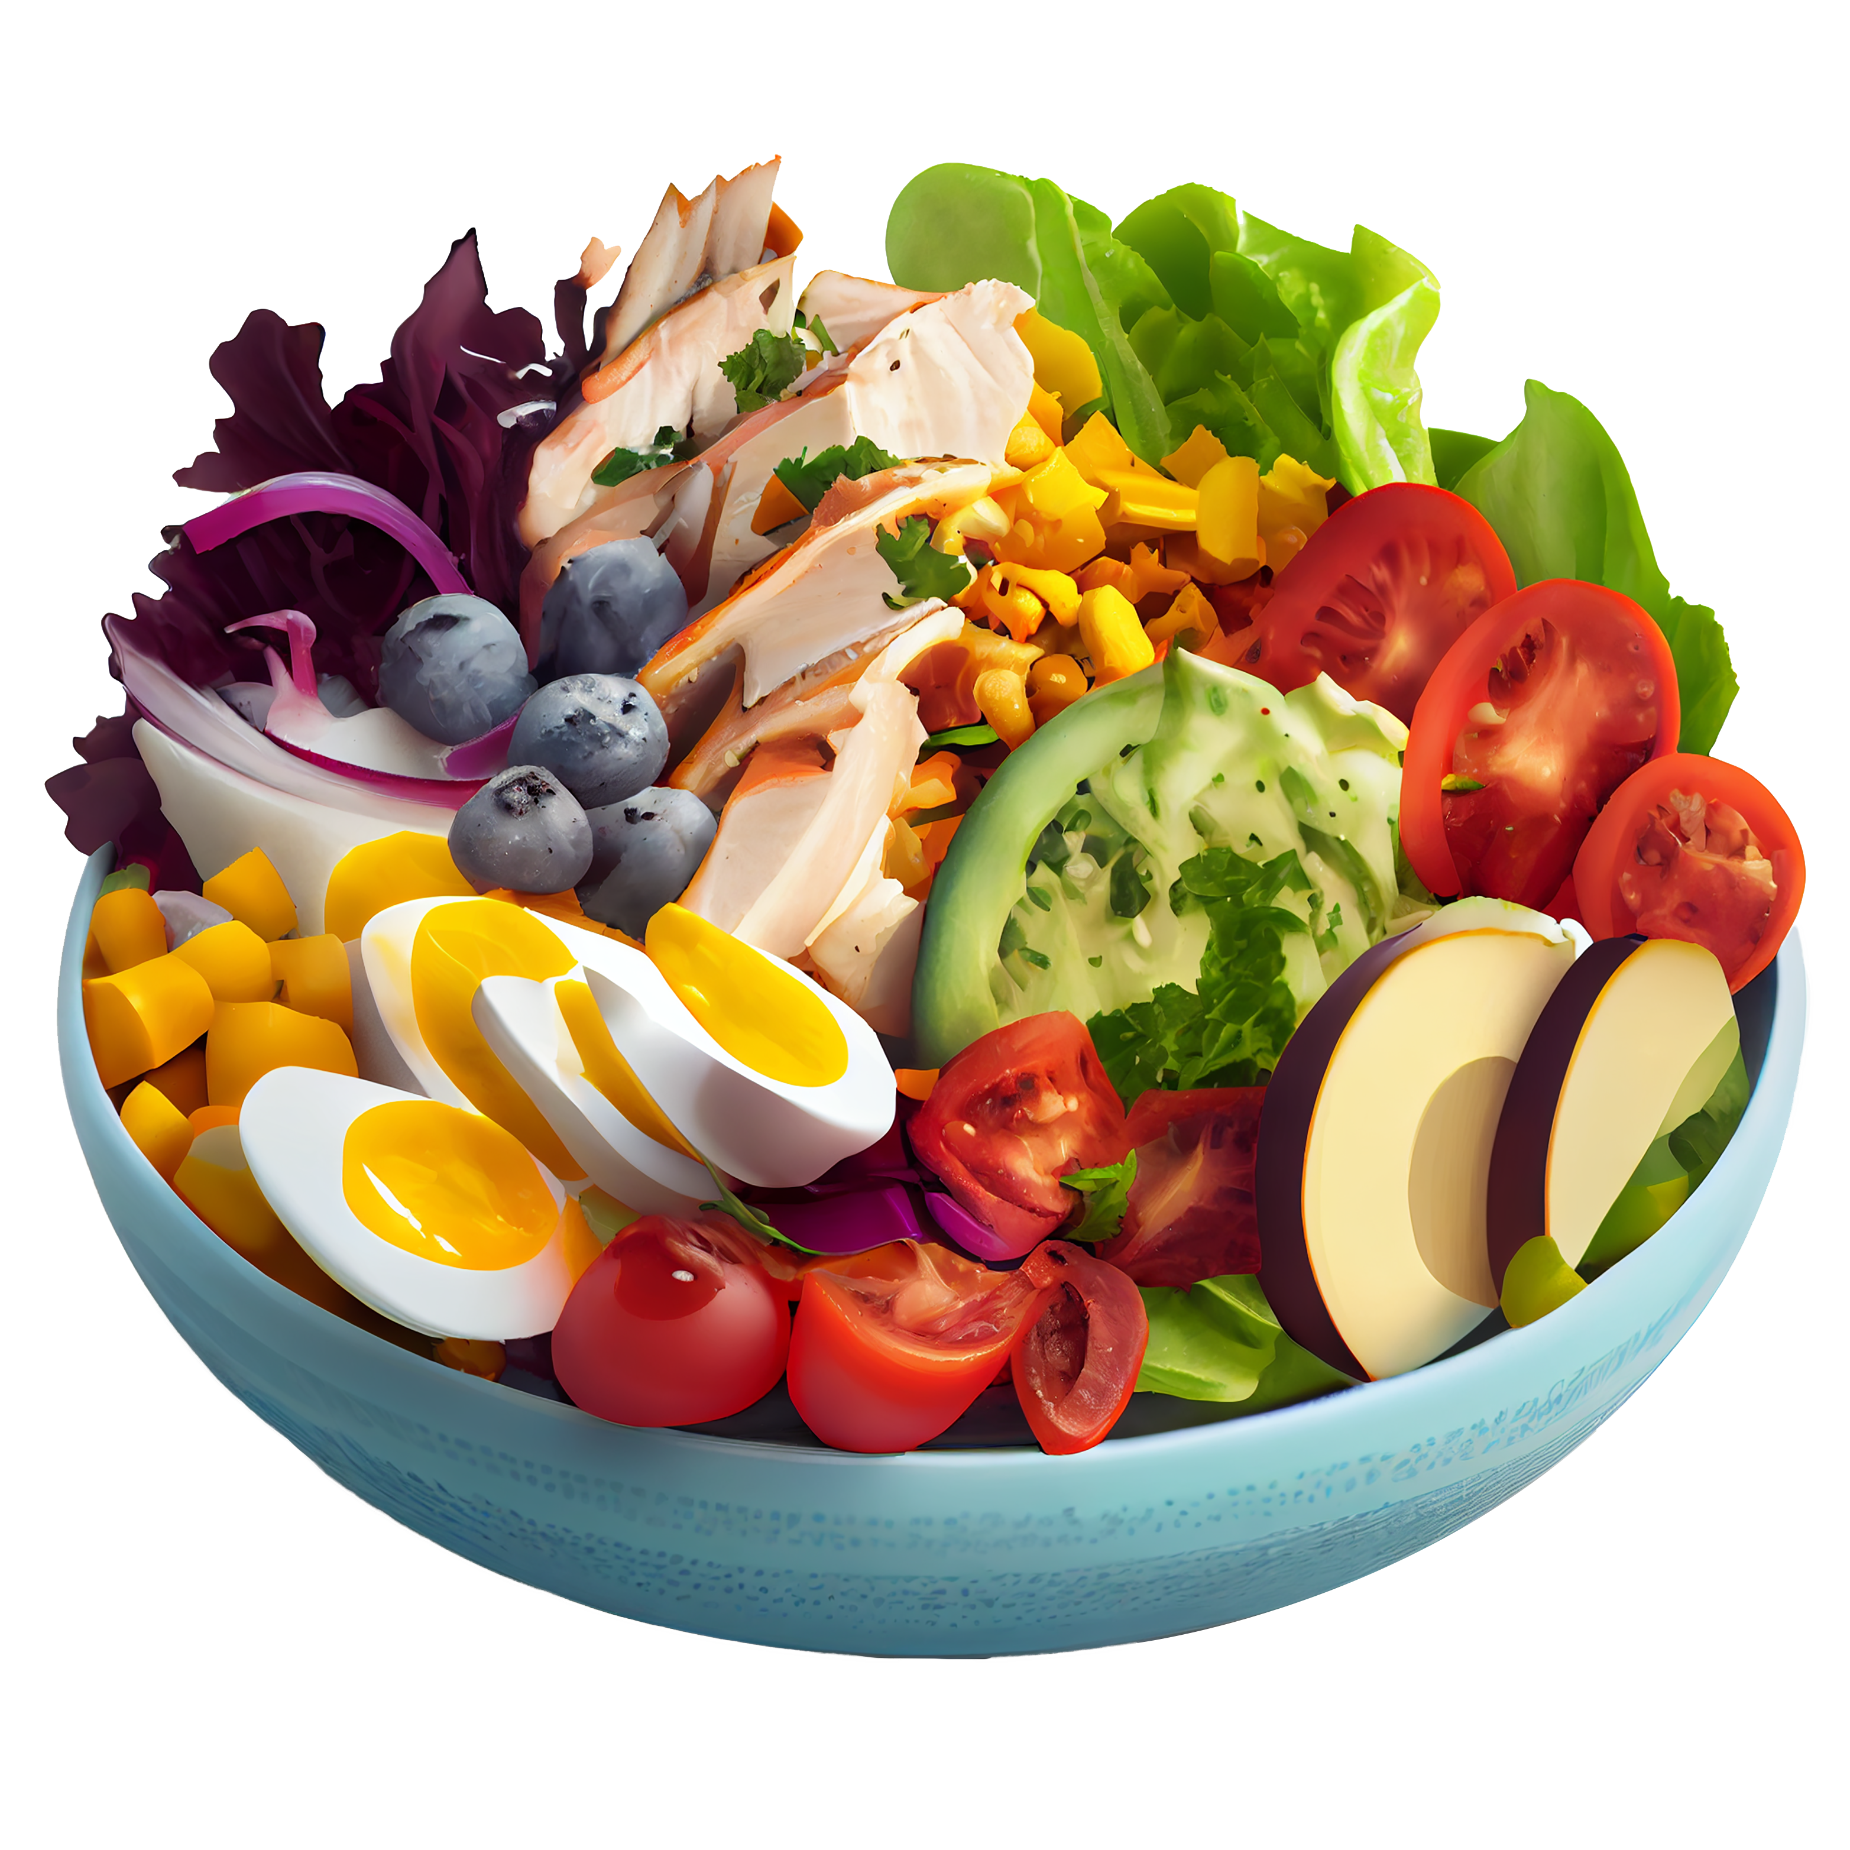

Hi-Fidelity Wireframes

Slide 21
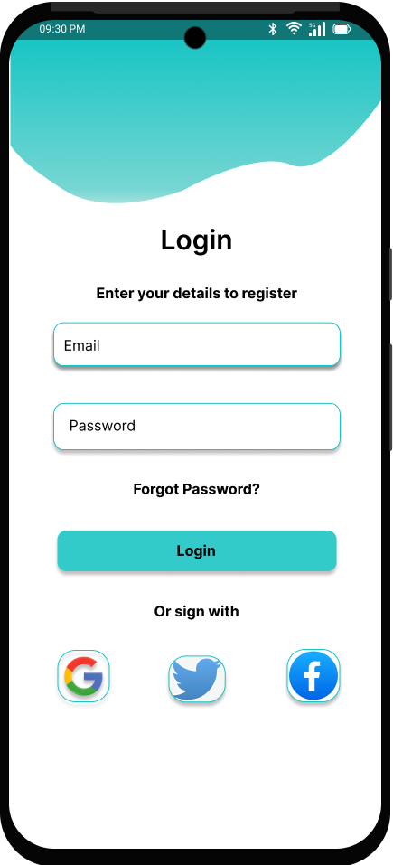
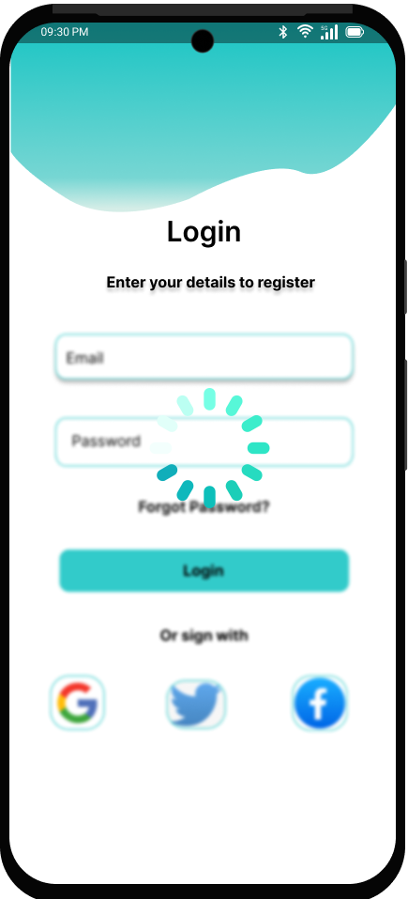
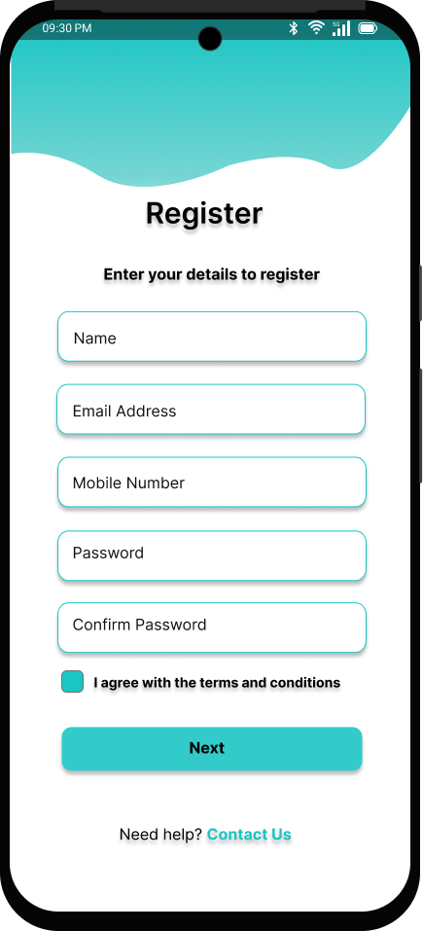
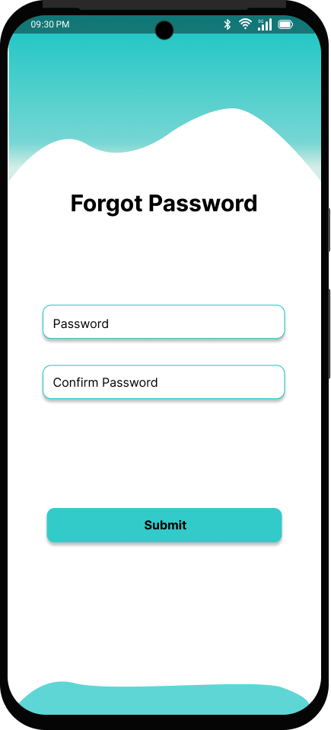
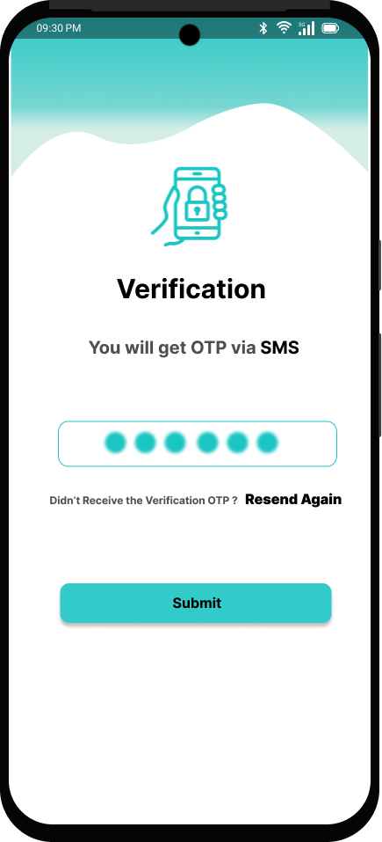

Login and Registration
Splash Screen (NutriFit Welcome)
Serves as the app’s welcoming screen with the logo and slogan: “Track | Train | Transform.”
Features a fitness-themed illustration and a prominent “let’s get started” button to proceed.
Login & Registration Screens
The Login screen includes fields for email and password with options to sign in via Google, Twitter, or Facebook.
The Register screen captures user details including name, email, mobile number, and password confirmation, along with terms and conditions acceptance.
OTP Verification & Password Reset
The OTP screen guides users through SMS-based OTP input for secure verification.
The Forgot Password screen allows users to reset their password with password and confirmation fields.

Slide 22
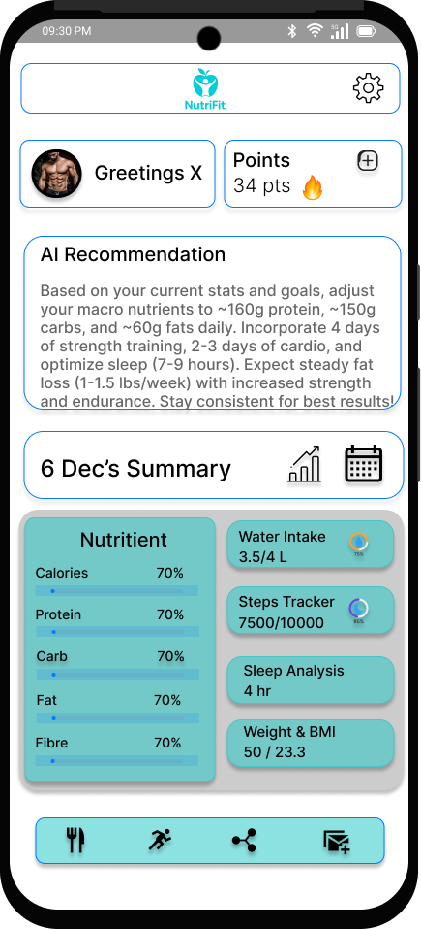
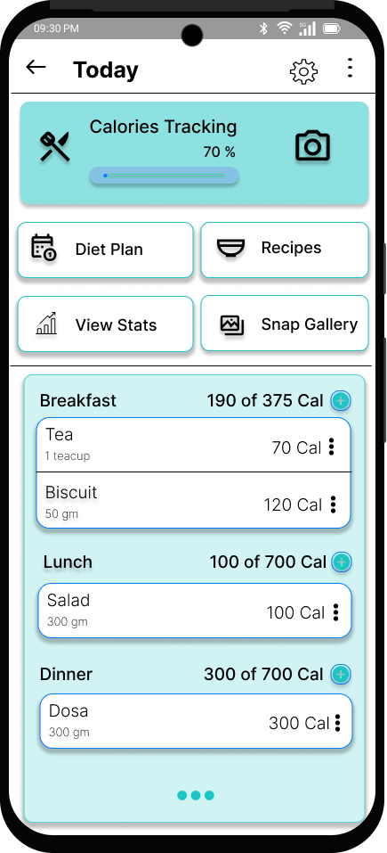
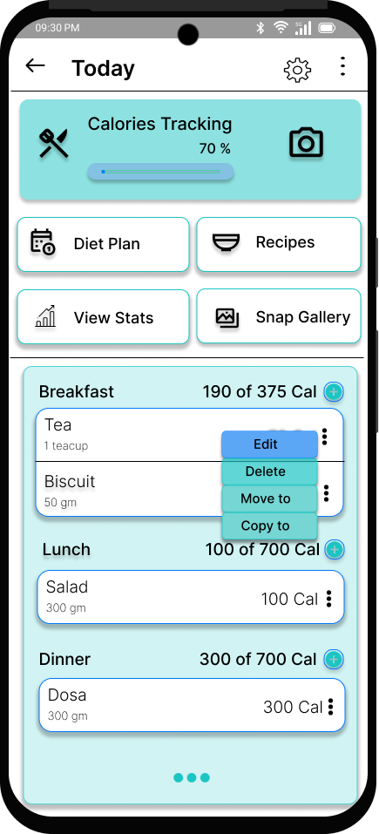
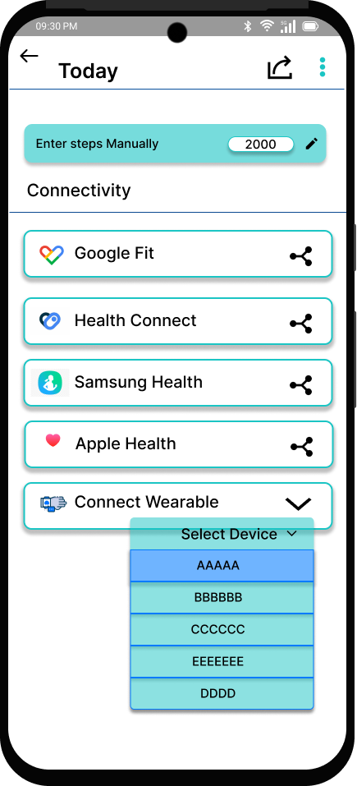
On Boarding and Tracking
Seamless Health Sync: The app supports connectivity with multiple health platforms like Google Fit, Samsung Health, Apple Health, and wearables, allowing users to sync their steps and activity data effortlessly.
Smart Calorie Tracking: Users can log their meals with calorie details, track daily intake against goals, and easily edit or manage entries, promoting accurate nutrition tracking.
AI-Driven Personalization: The home screen features AI recommendations tailored to user stats and fitness goals, offering guidance on macros, workouts, and sleep for optimized progress.
Gamification & Progress Insight: With points, visual progress bars, and a clean summary of daily metrics (water, sleep, steps, BMI), the app keeps users motivated and informed through intuitive and interactive feedback.

Slide 23
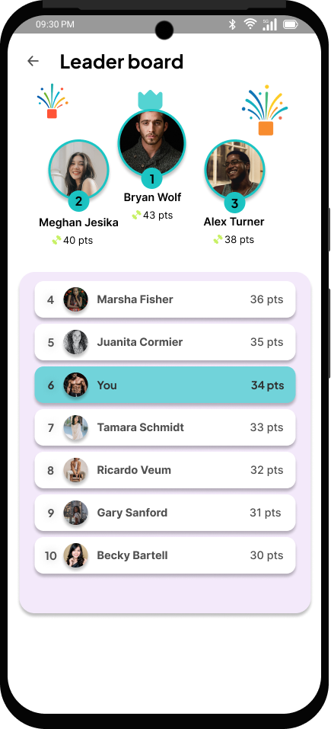
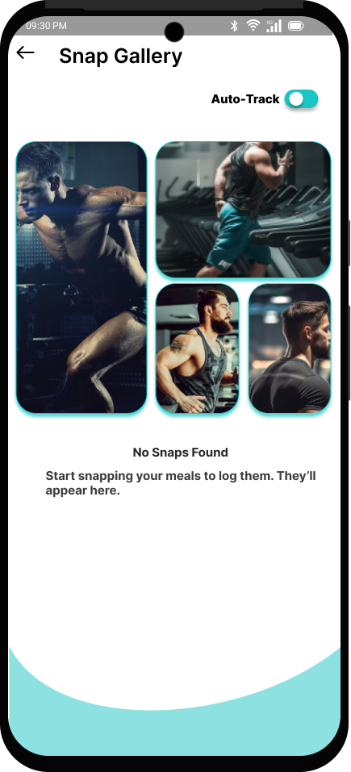
Gamification and Auto Tracking
Gamification via Ranking & Leaderboard: Your app uses a leaderboard system to foster a competitive environment where users can track their progress relative to others. This gamified approach motivates users to stay consistent with workouts and meal tracking to climb the ranks.
Auto-Tracking for Effortless Logging: The "Auto-Track" toggle allows users to automatically log their workouts or meals, reducing manual input. This feature ensures consistency and accuracy in tracking, making it easier for users to stay on top of their goals.

Slide 24
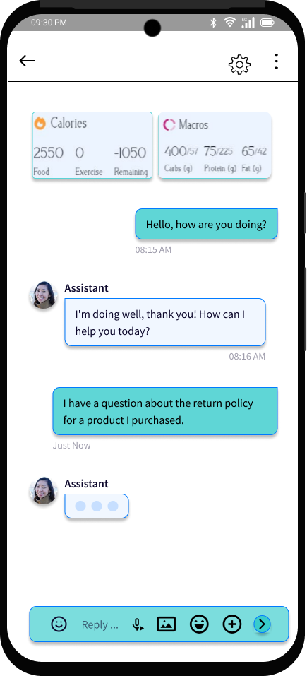
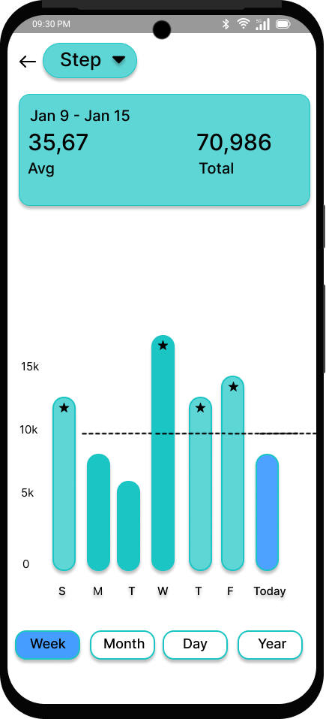
Chatbot and Statistics
Chatbot Assistant: A built-in AI-powered chatbot provides instant support and guidance. Users can ask questions about nutrition, workouts, app features, or general assistance, making the experience more interactive and engaging. The chatbot also integrates calorie and macro tracking, allowing users to manage their diet seamlessly within the conversation.
Statistics & Step Tracking: The analytics page displays detailed step tracking data, including daily, weekly, monthly, and yearly insights. Users can view total steps, averages, and trends through an intuitive bar chart, helping them stay motivated and monitor their activity levels over time.

Slide 25
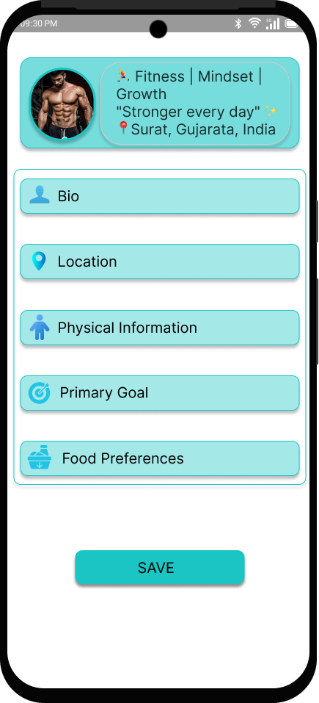
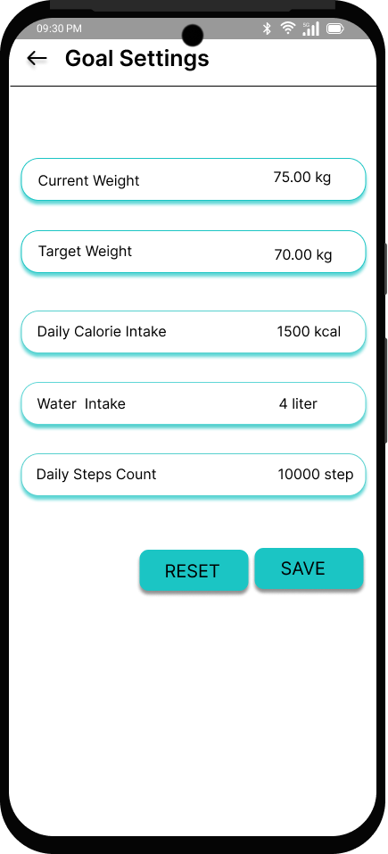
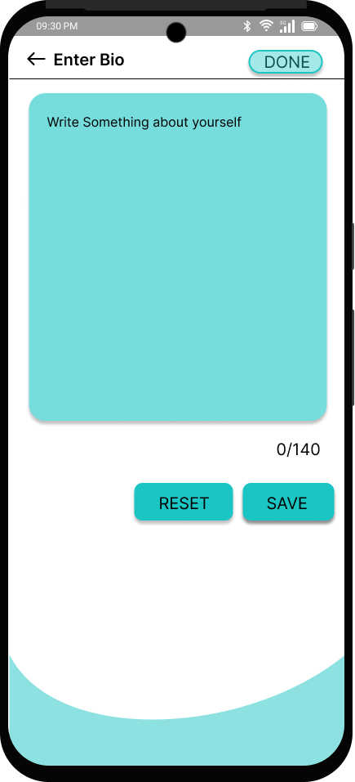
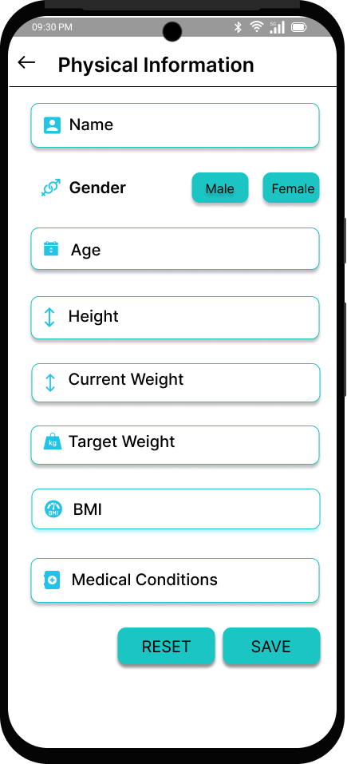
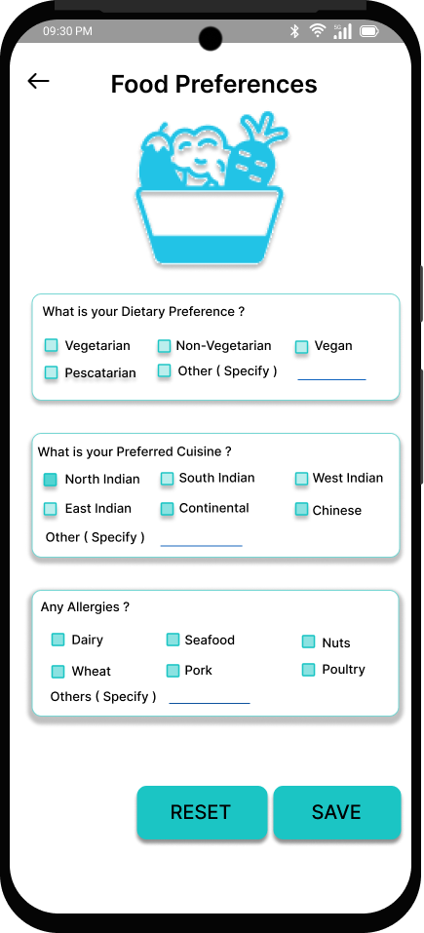
User Profile and Personalization
Comprehensive User Profile – Users can input and manage personal details such as name, location, and primary diet to receive tailored fitness and nutrition recommendations.
Physical Information Tracking – The app allows users to record essential details like height, weight, age, gender, and medical conditions for accurate health tracking.
Personalized Goal Setting – Users can set and track their weight-related goals, including current weight, target weight, and ideal calorie intake, ensuring a structured fitness journey.
Food Preferences & Dietary Customization – The app lets users specify dietary preferences and restrictions, allowing it to generate personalized meal plans that align with their nutritional needs.

Slide 26
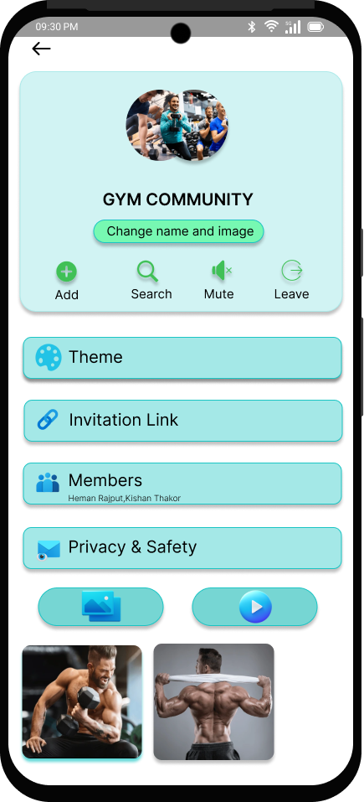
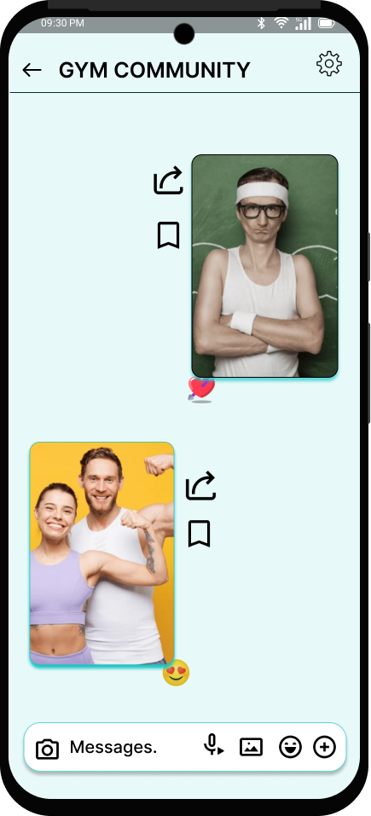
Community
Interactive Fitness Community – Users can join or create gym communities to connect with like-minded fitness enthusiasts, fostering motivation and support.
Customization & Management – The community can be personalized with a name, image, and theme, while features like invitation links and member management provide seamless control.
Privacy & Safety Controls – Users can manage privacy settings to ensure a safe and comfortable environment for discussions and interactions.
Multimedia Chat & Engagement – The built-in chat allows members to share images, reactions, and messages, making it easy to discuss workouts, progress, and fitness tips in real-time.

Slide 27
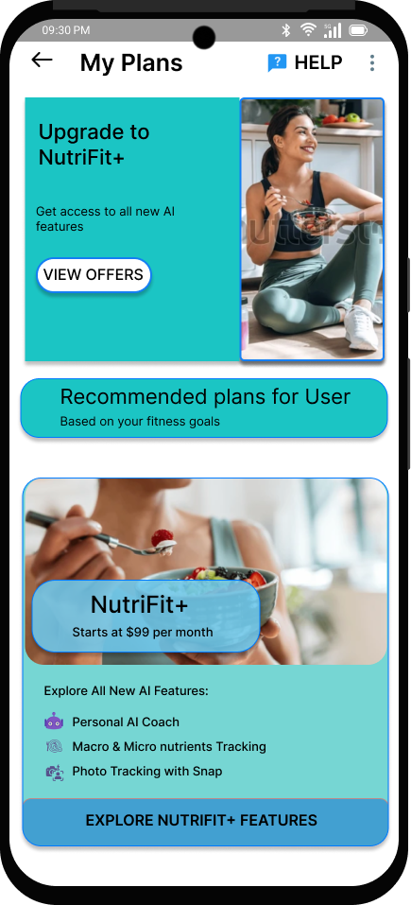
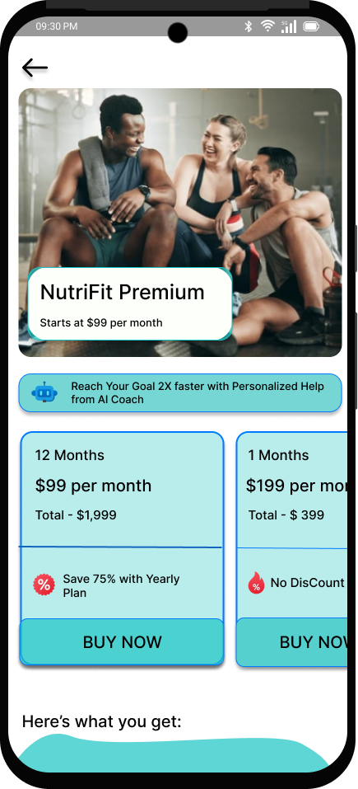
Subscription and Plans
Personalized Subscription Plans – Users can access recommended plans based on their fitness goals, ensuring a tailored experience that meets their individual needs.
Premium Features & Benefits – The NutriFit+ plan includes exclusive benefits such as personalized coaching, AI-driven fitness tracking, and meal & nutrition-based training for enhanced progress monitoring.
Flexible Pricing Options – Users can choose between monthly and yearly subscription plans, with significant savings on long-term memberships (e.g., 75% off for a 12-month plan).
Seamless Upgrade & Purchase – A user-friendly interface allows quick plan upgrades and purchases, making it easy to access premium features with just a few taps.

Slide 28
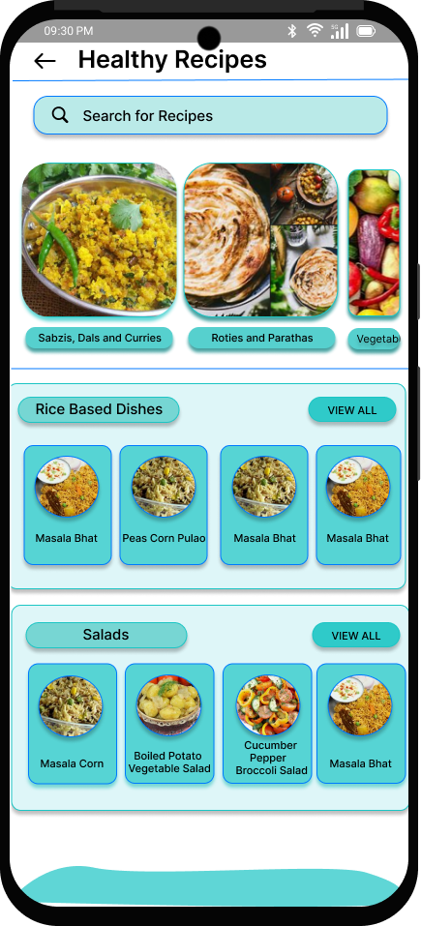
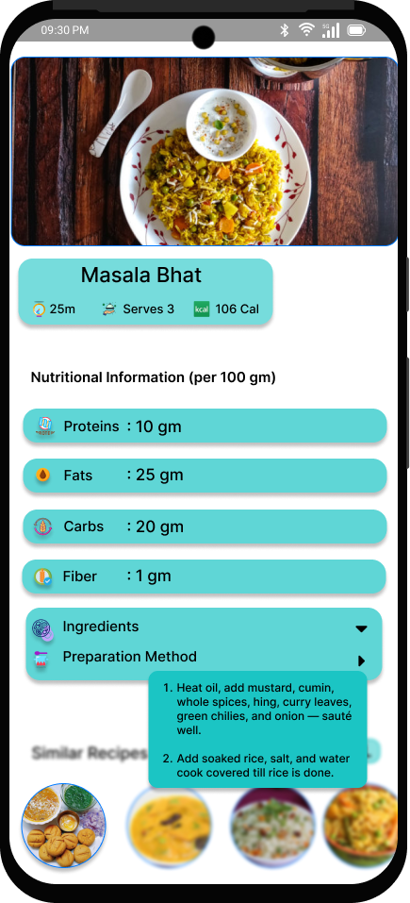
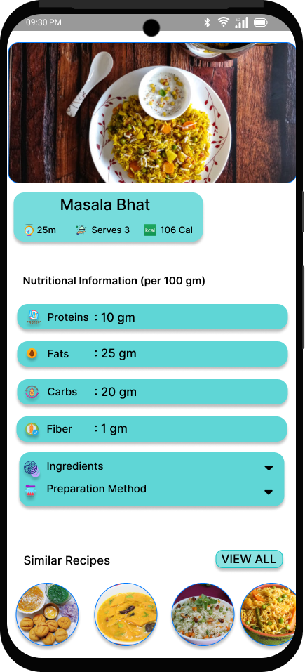
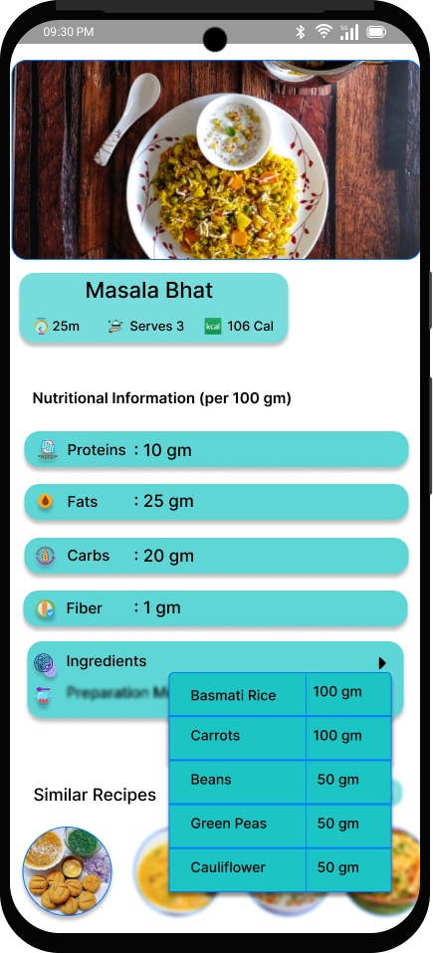
Diet Plan and Recipe
Recipe Categorization & Search – Users can easily explore a variety of healthy recipes, organized into categories like "Rice-Based Dishes" and "Salads," with a convenient search function for quick access.
Detailed Nutritional Information – Each recipe includes a breakdown of nutritional values per 100g (proteins, fats, carbohydrates, and fiber), helping users make informed dietary choices.
Step-by-Step Preparation Guide – The app provides a detailed ingredients list and preparation method, ensuring users can follow along easily to cook their selected dish.
Similar Recipe Suggestions – Users get recommendations for similar recipes, making it easy to discover new dishes based on their preferences and dietary goals.

Slide 29
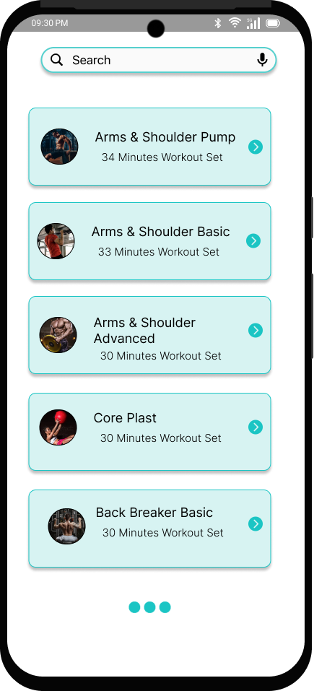



Workout and Exercise
Workout Selection & Categorization – Users can choose from a variety of workouts categorized by muscle groups, such as "Arms & Shoulder Basics" or "Biceps and Back Training," making it easy to find targeted exercises.
Personalized Workout Experience – Each workout includes details like estimated duration, difficulty level, and progress tracking, allowing users to select exercises that match their fitness level.
Guided Exercise Tutorials – The app provides step-by-step tutorials with video demonstrations to help users perform exercises correctly and safely, enhancing the overall training experience.

Slide 30


